Slide 1
China AMS – Monthly Governance Dashboard
Apr 2020

Slide 2

Agenda
1
Action items – Previous Meeting
2
Executive Summary
Open Issues & Risks & Suggestions
3
AMS Operations Summary
4
Release management updates
5
Appendix
6

Slide 3
Action Items – Previous Meeting
No. | Action Items | Owner | ETA | Status | Tracking Comments
1 | Interview and focus group discussion with MetLife AMS stakeholders to come up with process improvement plan | Cognizant | 2020/6/31 | Ongoing | Partial action is implemented like quick daily report at Wechat, rests communication template plan to implement since Jun.

Slide 4
Executive Summary
Key Highlights
AMS team did daily support in alternate ways during the 3 days of access revoked, there was no major impact caused by access issue.
One AMS team member was requested to leverage to support Data team for external audit preparation in end of Apr and OT during labor day holiday.
MTS team is requested to do urgent support for data correction during Labor day holiday.
PTASK0069139:In the policy loan business, manual approval is required for types of credit card such as industrial credit card, China Merchants credit card and Bank of Communications credit card. However, the source code for bank code verification is hard coded in Pass system, result in the manual approval is skipped and transactions can make successfully without manual approval. The code has now been fixed and make it configurable.
Pass
PRB0055151: Surrender application data synchronization failed in MTS from CSS system due to table got deadlocked during synchronizing. The Solution is optimizing the job code and add one temporary table for storing the data going to be updated, meanwhile add row lock in terminate table to avoid the deadlock.
MTS

Slide 5
AMS Operation Summary
Incident Management
Handled 222 tickets in Apr’20
32.1% increase in incident trend compared to previous Month.
Top 3 applications were PASS, WeChat and ODS
Service Requests
Handled 279 service requests in Apr’20
MTS system has more SR tickets.
Problem Management
11 Problem tickets opened and 13 tickets closed in Apr’20, from Service Now.

Slide 6
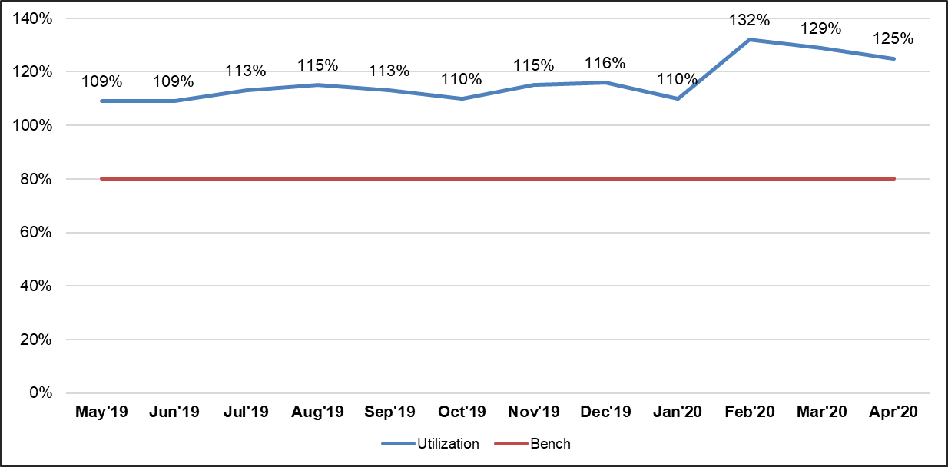
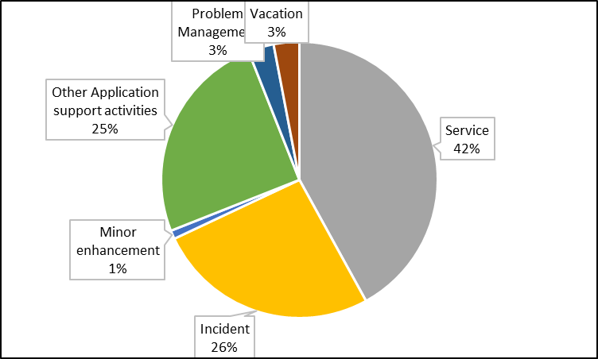
Demand vs Capacity (Apr)
Resource Utilization Percentage - Overall
Effort Split – Service Wise
Application-Wise Effort Split (Hours)
Overall Apr DCV (Delivered capacity variance) without vacation is 25% ; (DCV with Vacation is 29%)

Slide 7
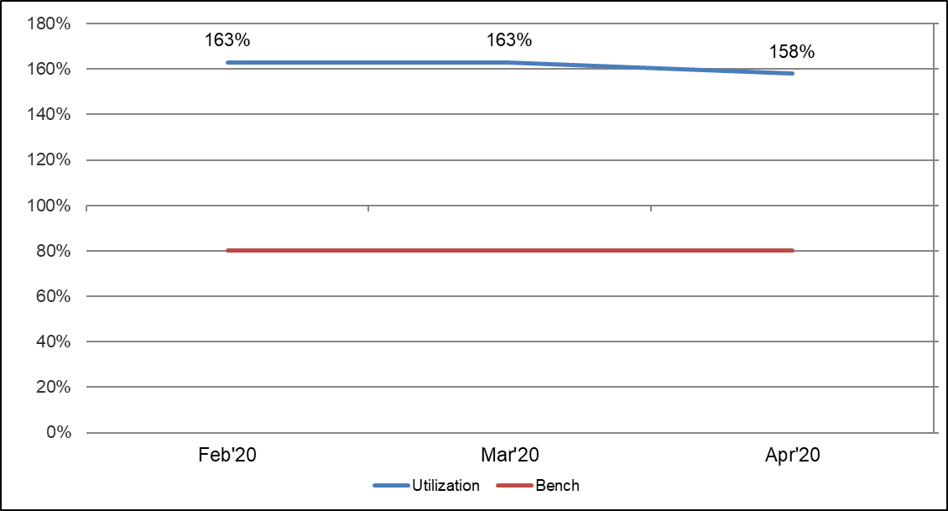
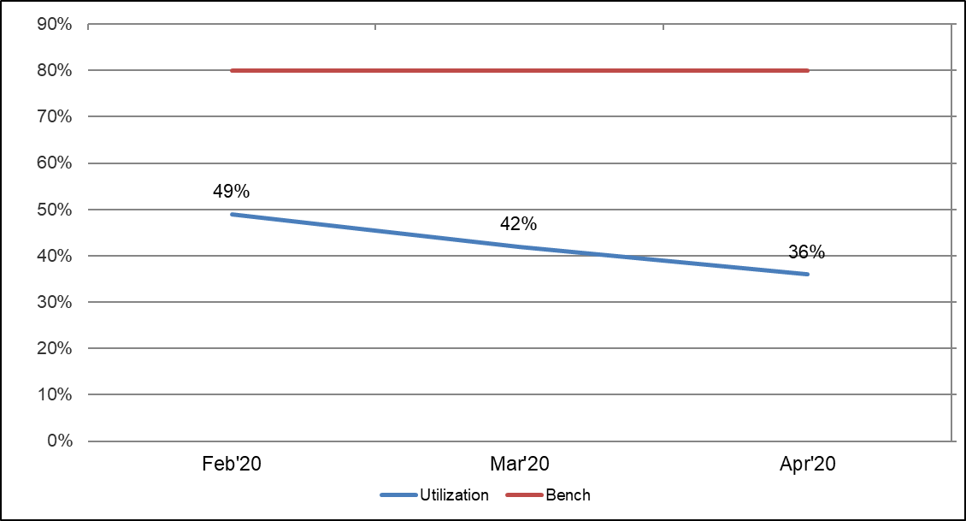
Demand vs Capacity (Apr)
Resource Utilization Percentage - OBS
Resource Utilization Percentage - CBS
Application-Wise Effort Split (Hours)
Overall Apr DCV for OBS without vacation is 58% ; (DCV with Vacation is 62%)
Overall Apr DCV for CBS without vacation is -64% ; (DCV with Vacation is -50%)

Slide 8
Release Management Improvement
There is no failure, rollback or incident happened in this month.
Status Report

Slide 9
Release Management
Comments
Release Result:
Successful - 114
Completed with issues - 0
Unsuccessful (no business impact) - 0
Unsuccessful - 0
Not Closed - 2

Slide 10
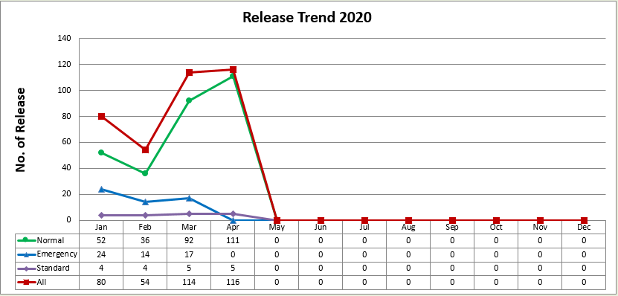
Release Management

Slide 11
Appendix

Slide 12
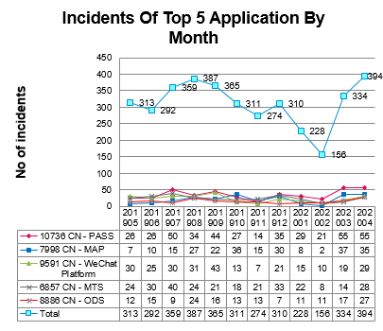
Incidents – AMS China
Comments
Total number of incidents increased by 18%, compare to number of month of Mar 2020.
The number is getting beck to same level as last year.
Top 5 application are PASS, MAP, WeChat Platform, MTS, ODS,

Slide 13
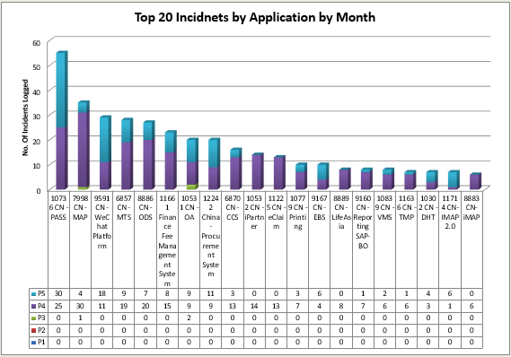
Incidents – Top Applications – AMS China
Comments
There is no P1, P2 incident in Apr.
2. Top 5 applications are PASS, MAP, WeChat, MTS and ODS,

Slide 14
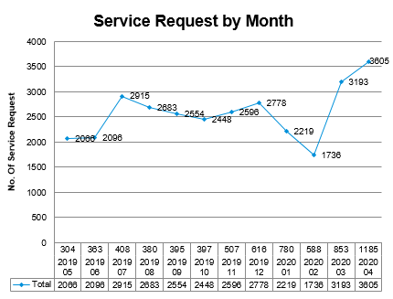
Service Requests – AMS China
Comments
Service Request tickets increased by 12.9% compare to number of month of Mar.

Slide 15
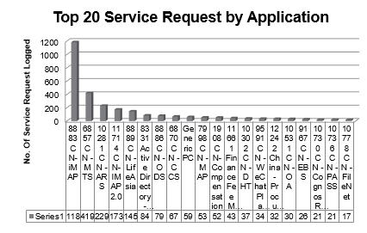
Service Requests – Top Applications – AMS China
Comments
1. iMap, MTS and ARS are top 3 applications of service request for current month.
Top 3: 1833 50.0%
Top 20: 2806 77.8%
_____________________________
All: 3605

Slide 16
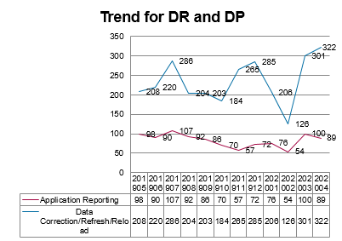
Trends for Data Request and Data Patch – AMS China
Comments
The total no. of DR tickets decreased by 11%, compare to number of month of Mar.
The total no. of DP tickets increased by 6.9%, compare to number of month of Mar

Slide 17
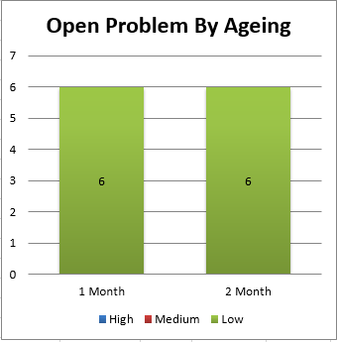

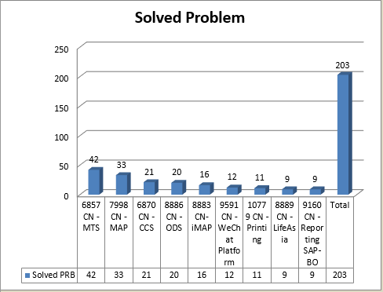
Problem Ticket –Ageing – AMS China
Comments
There is no High and Medium Open problem tickets until end of Jan
6 open problems aging are in 1 month and 6 open problems are over 2 month at the end of Apr, 2020.
6 of 12 open problems are either in UAT phase or waiting for PRD deployment.
In recent 12 months, there are 203 problems resolved. Top 3 application are MTS, Map and CCS.

Slide 18
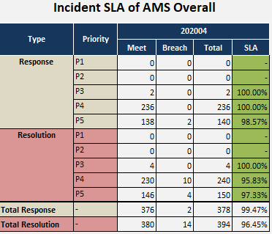
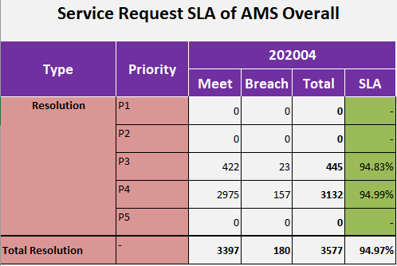
SLA – AMS China
Comments
Incident SLA are all green for AMS overall.
Service Request SLA are all green for AMS overall

Slide 19
List of Applications Supported by Cognizant
SI.No | EAI Code | Application Name
1 | 9500 | AEM, Gsvp
2 | 10727 | AURA
3 | 10729 | AV&CDR
4 | 7373 | CIRC Reporting
5 | 11225 | eClaim
6 | 11360 | Email Management System
7 | 11465 | eNotice
8 | 10739 | E-Opening
9 | 10778 | FileNet
10 | 10740 | Gonghui Database
11 | 10074 | iBox EB
12 | 11714 | iMap 2.0
13 | 8883 | iMAP1.0
14 | 10779 | Printing
15 | 10742 | MDES
16 | 6857 | MTS
17 | 8886 | ODS
18 | 7200 | One Quotation
19 | 10736 | PASS
20 | 8886 | Re-Insurance ETL
21 | 10730 | Reporting CSO
22 | 9160 | SAP BO Reporting
23 | 10777 | Scanning
24 | 11466 | SMIS
25 | 9165 | SMS
26 | 9166 | Web Portal
27 | 9591 | WeChat Platform-官微
28 | 10302 | WeChat Platform-都会堂
29 | 10723 | WTS
30 | 11239 | Xiehui Database
31 | 11862 | JIRA
32 | 10839 | VMS
33 | 11430 | DTC(SWAN)
34 | 10279 | BMP
35 | 10281 | ARS
36 | 10321 | RPIS
37 | 10838 | EZT
38 | 10904 | EBWechat
1 | 10725 | WebERP (Offline)
2 | 10728 | Sales portal (Offline in May 2019)
3 | 7796 | iCare (Offline)
4 | 7374 | CIRC Audit (Out of scope)
5 | 10638 | DM/TM BI (Offline)
6 | 9524 | Helpdesk (Offline)

Slide 20
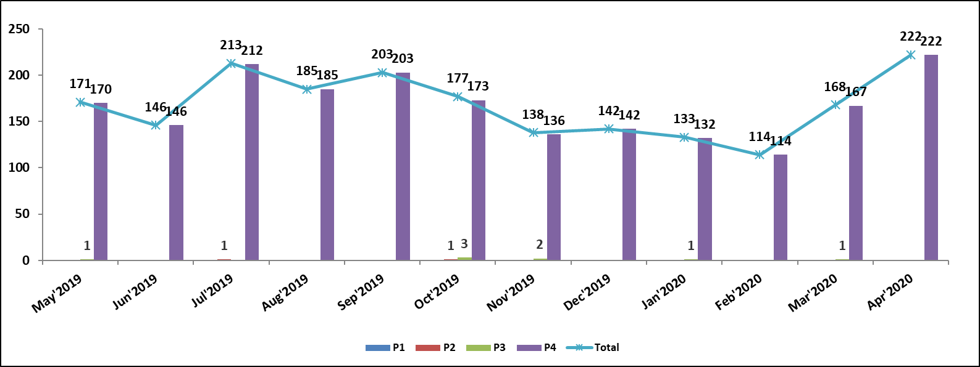
Summary - Incident Management & Service Requests
Incoming Trend – Incident Management

Slide 21
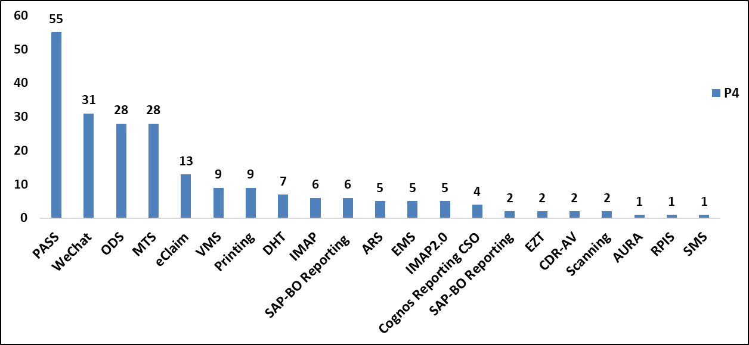
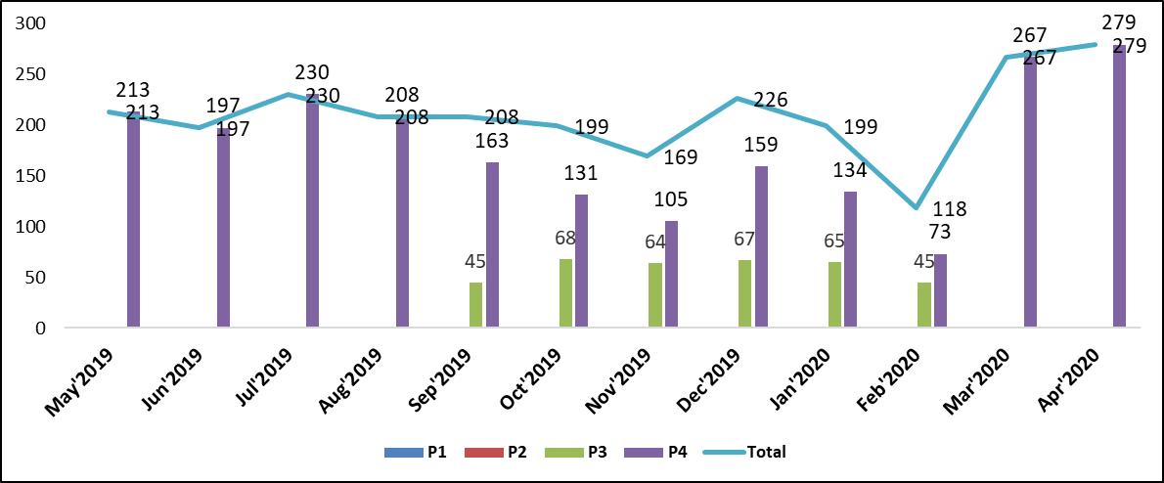
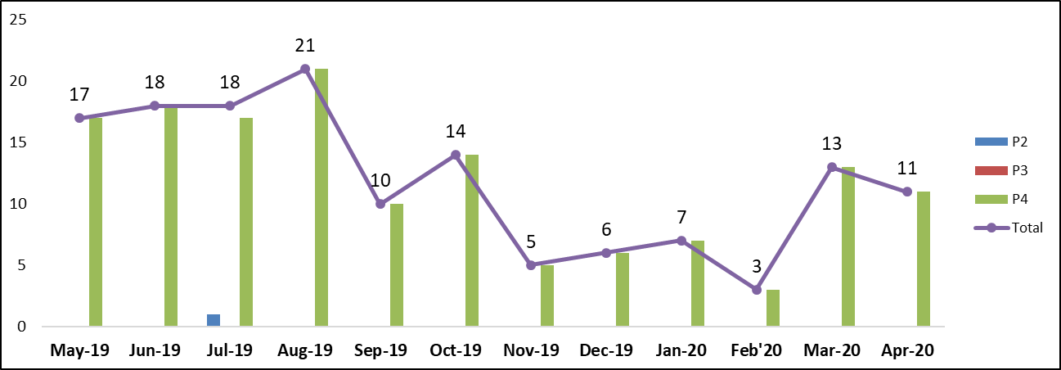
Summary - Incident Management & Service Requests
Incident Management – AppWise - Apr’20
Incoming Trend – Service Management
Incoming Trend – Problem Management
Handled 222 Incidents in Apr’20.
PASS, WeChat and ODS are the Top 3 Applications
Handled 279 service requests in Apr’20.

Slide 22
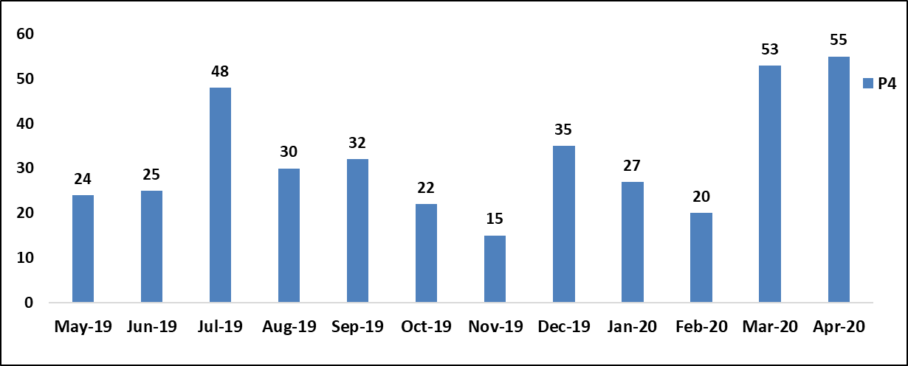
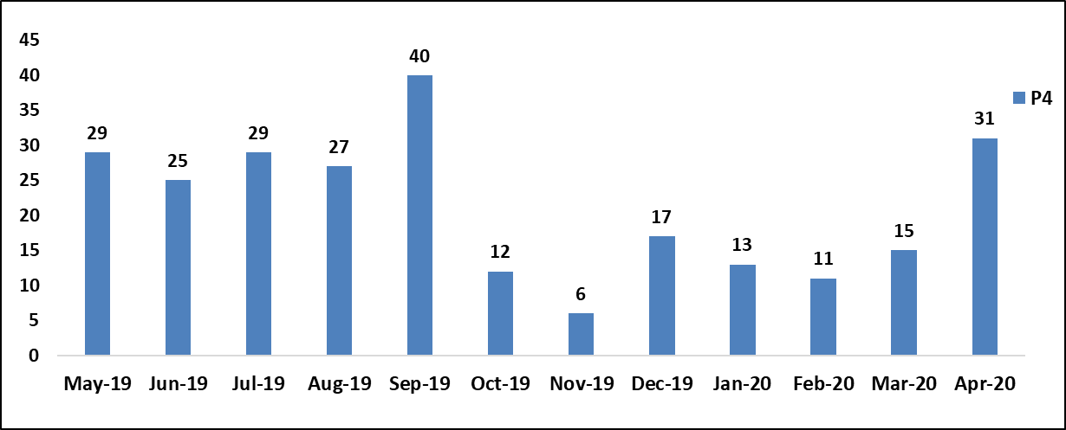
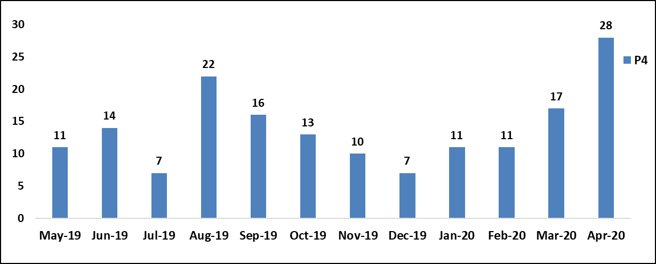
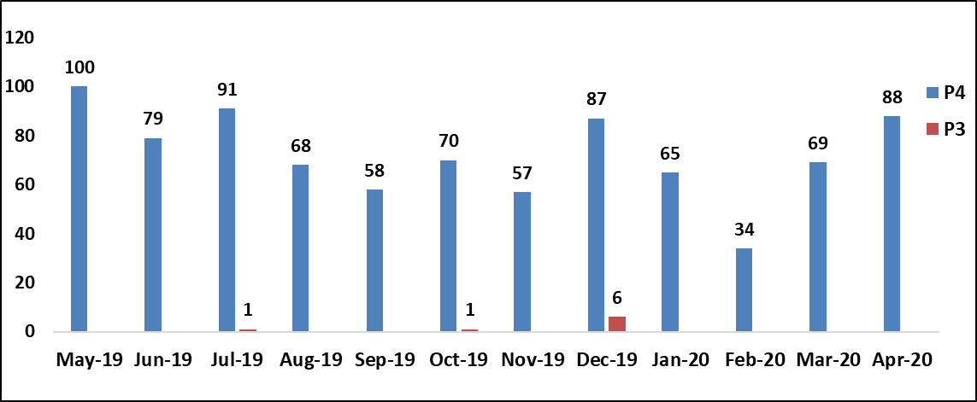
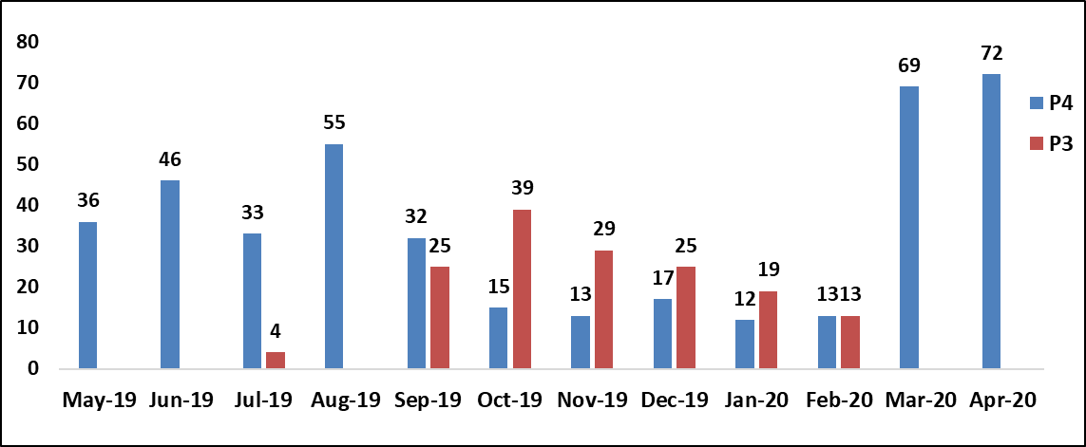
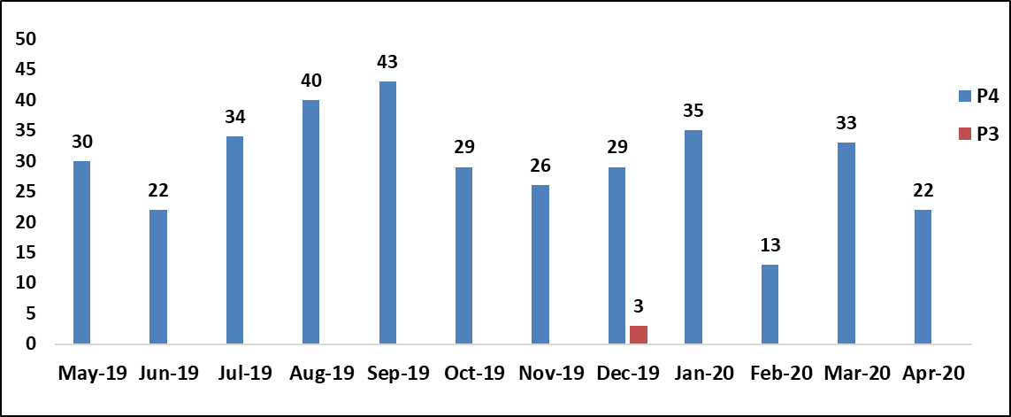
Executive Summary - Incident Management & Service Requests
INCIDENT TREND-PASS
INCIDENT TREND-WeChat
INCIDENT TREND-ODS
Service Request TREND-MTS
Service Request ODS
Service Request TREND-Blanks

Slide 23
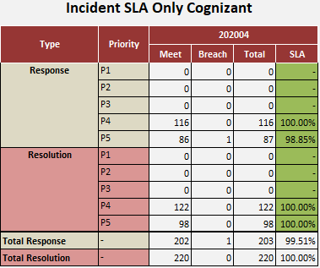
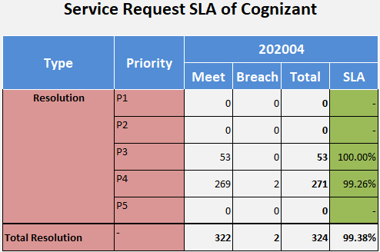
SLA – Cognizant
Comments
Incident SLA is all green for Cognizant.
Service Request SLA is all green for Cognizant

Slide 24
SLA Dashboard
SLA Metrics | Severity | Expected SLA | SLA | Jun’19 | Jul’19 | Aug’19 | Sep’19 | Oct’19 | Nov’19 | Dec’19 | Jan’20 | Feb’20 | Mar’20 | Apr’20 | May’20
INC-Response time | P1 | 95% | 15 min | NA | NA | NA | NA | NA | NA | NA | NA | NA | NA | NA | NA
 | P2 | 95% | 30 min | NA | 100% | NA | NA | NA | NA | NA | NA | NA | NA | NA | NA
 | P3 | 90% | 1 hr | 100% | NA | NA | NA | 100% | 98% | 98% | 100% | NA | 100% | NA | NA
 | P4 | 90% | 2 hrs | 97% | 93% | 97% | 98% | 100% | 96% | 100% | 100% | 98.08% | 97.83% | 98.5% | 97%
INC-Resolution Time | P1 | 100% | 2 hrs | NA | NA | NA | NA | NA | NA | NA | NA | NA | NA | NA | NA
 | P2 | 91% | 3 hrs | NA | 100% | NA | NA | 100% | 100% | NA | NA | NA | NA | NA | NA
 | P3 | 91% | 6 hrs | 100% | NA | NA | 100% | 100% | 96% | NA | 93.33 | NA | 100% | 100% | NA
 | P4 | 91% | 8 hrs | 96% | 97% | 91% | 96% | 97% | 100% | 98.2% | 96.67% | 96.72% | 100% | 100% | 100%
SR-Response time | P2 | 95% | 30 min | NA | NA | NA | NA | 100% | 100% | NA | NA | NA | NA | NA | NA
 | P3 | 90% | 1 hr | NA | NA | NA | 100% | 100% | 100% | 100% | 100% | 100% | NA | NA | NA
 | P4 | 90% | 2 hrs | 90% | 93% | 95% | 95% | 100% | 100% | 100% | 100% | 100% | 90% | 95% | 97%
SR-Resolution Time | P2 | 91% | 1 BD | NA | NA | NA | NA | 100% | 100% | NA | NA | NA | NA | NA | NA
 | P3 | 91% | 3 BD | 100% | 100% | 100% | 94% | 93% | 91% | 92.65% | 95.31% | 88.64% | 100% | 100% | NA
 | P4 | 91% | 5 BD | 100% | 100% | 100% | 99% | 93% | 95% | 96.45% | 94.85% | 93.9% | 99.1% | 99.26% | 100%
SLA analysis.
SLA result is all green for the year 2019.
For P3 SLA breach ticket in Feb 2020, there are 3 tickets out of 5 were not closed in time although they were solved.

Slide 25
Value Added
Category | Sub category | Application | Description | Status | Savings | Implemented on
Application Hardening | Performance | ODS/SAP BO | Job optimization: Daily job run slowly. It lead to the downstream system were not available. ETL job transferred to procedure, and added index for SQL optimization.The job was improved to run quickly. Improved application availability by reducing the daily job running time from 5 hours to 2 hours. (savings of 3 hrs daily - 60 hrs per month) | Completed | 60 hrs / month savings for job, user can see the report at 9:00 | Jul-16
Automation | Reduce manual intervention | ODS/SAP BO | Long UAT operational time : In order to avoid affect production environment, not open automatically job in UAT. Have to call job manually. Opened PWX model for automatically job, reduced UAT operational time. | Completed | 0.5 man days for UAT per day | Jul-16
Application Hardening | Performance | ODS | ODS restore data slowness: ODS mirror database and SAP BO database were deployed in virtual machine (one blade machine). The concurrent tasks lead to IO resources been pre-empted. Physically separated ODS mirror database and SAP BO database. | Completed | Job running time is from 4 hours to 1 hours | Jul-16

Slide 26
Thank you

